Slide 1
How does DT works
DT Regressor

Slide 2
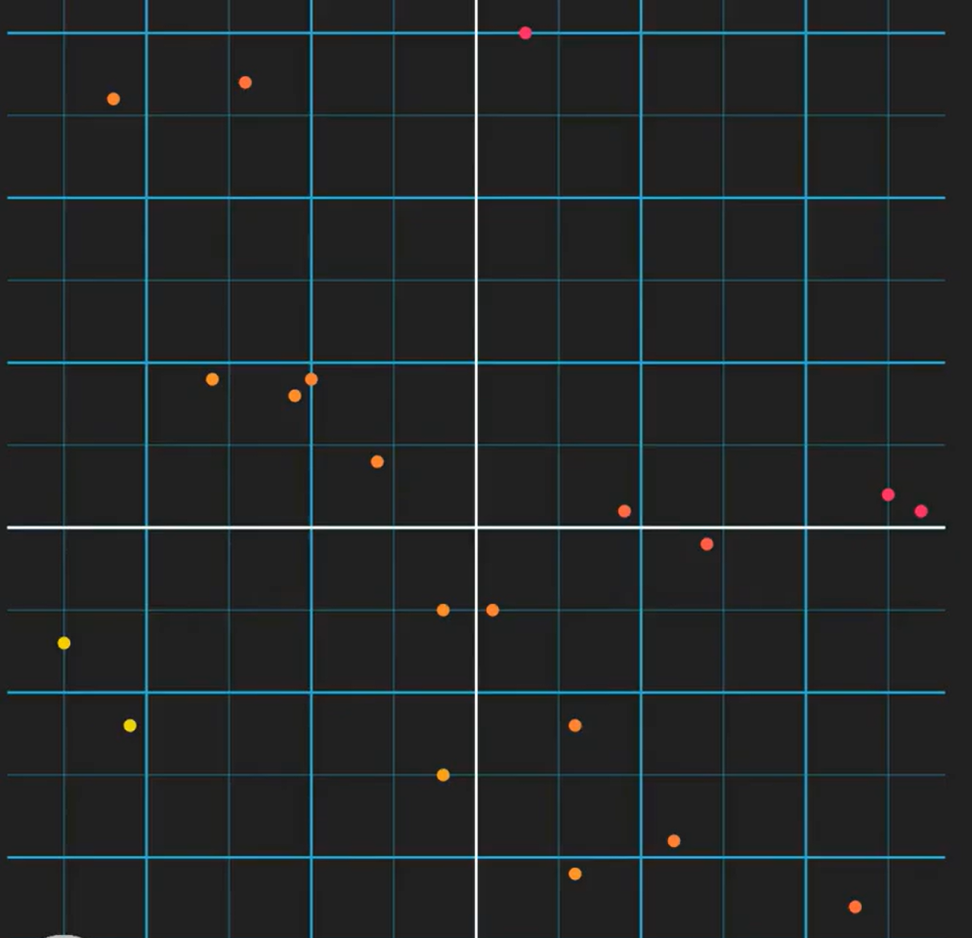
Here we have a dataset which has 2 features x0, x1 and y is the output which is been represented in colors where yellow will be lower values and the value increases as the color darkens to red.
So as we saw in DT Classifier, we split the data using a binary tree until we are left with pure leaf nodes.

Slide 3
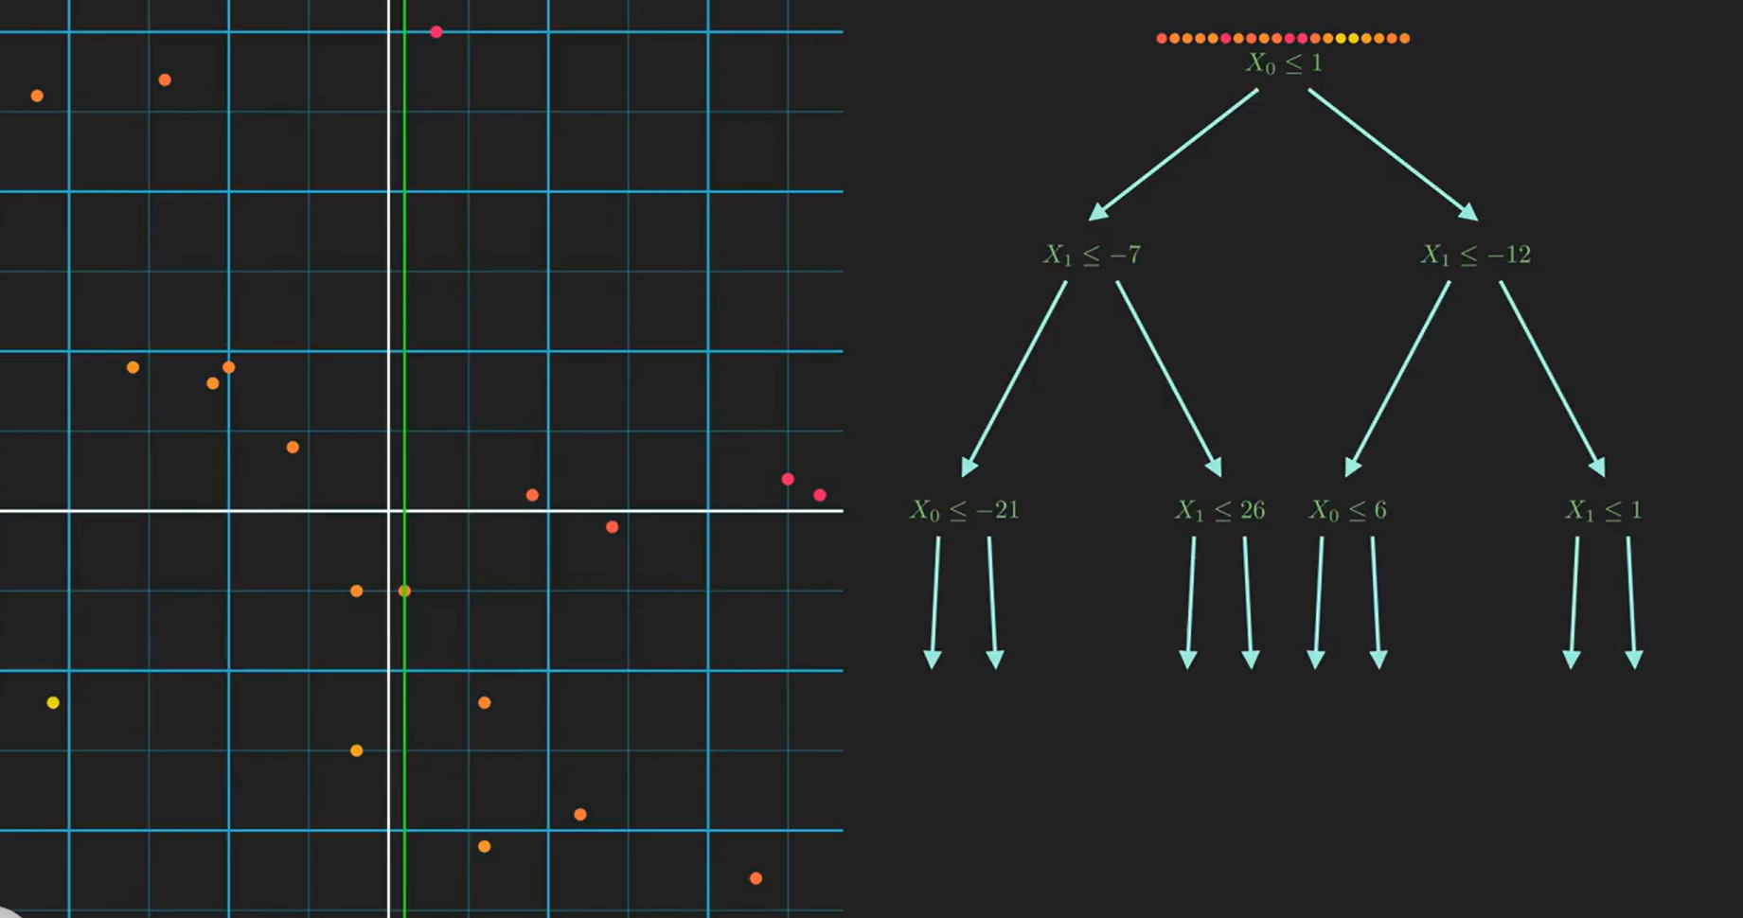



Slide 4
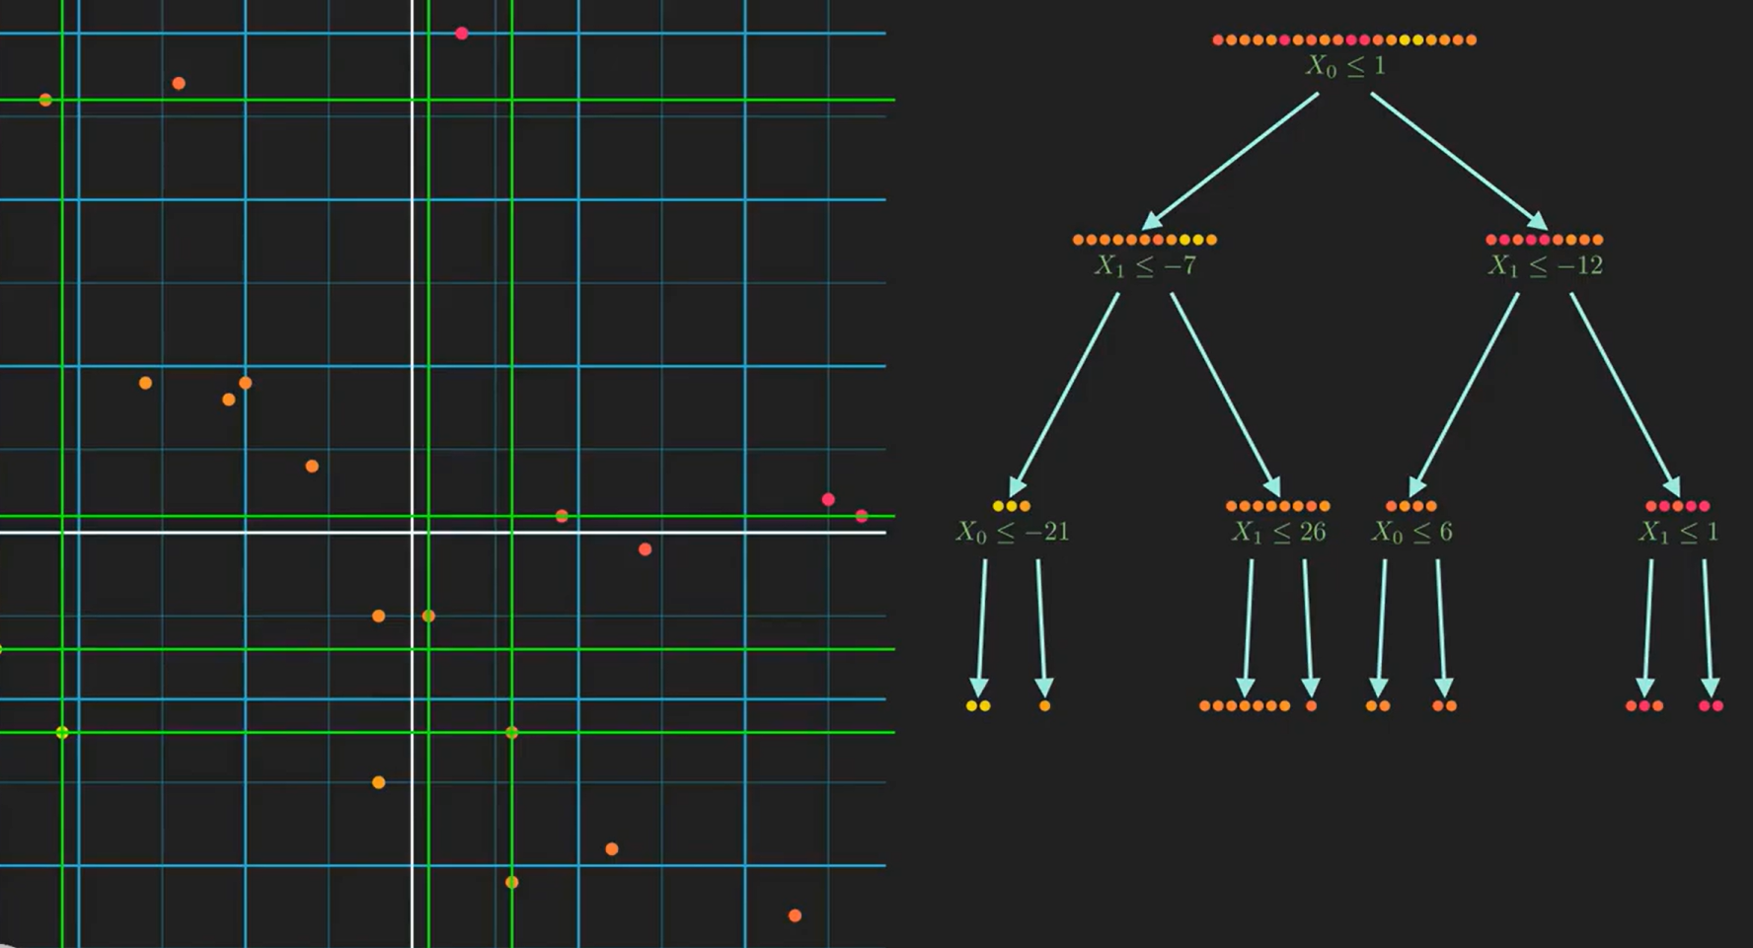
Now the model has identified the pattern in the data and is ready for prediction.

Slide 5
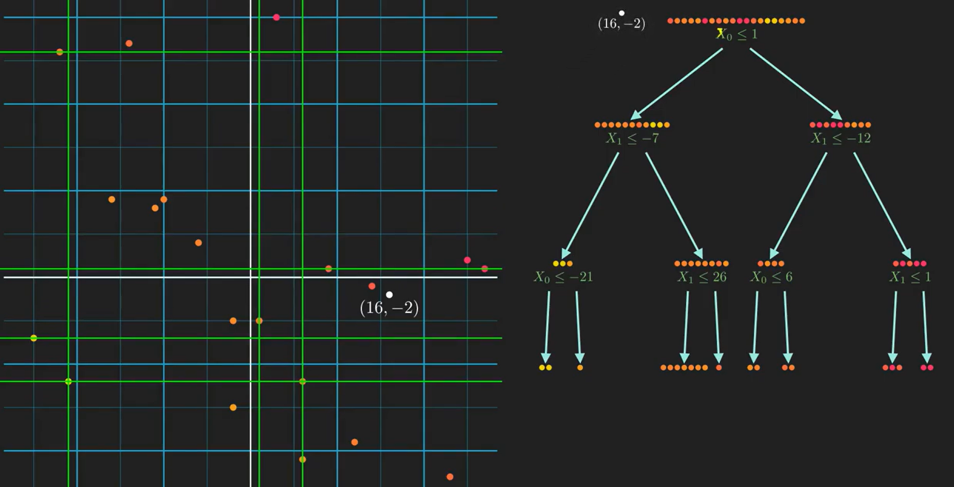
(X0, x1)
Predict the output for new input data (16,-2)

Slide 6
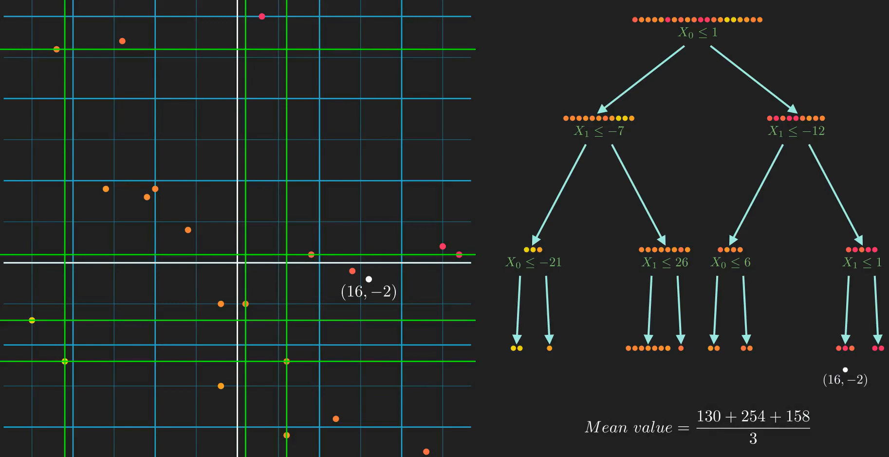




Slide 7
How to select the right feature?

Slide 8
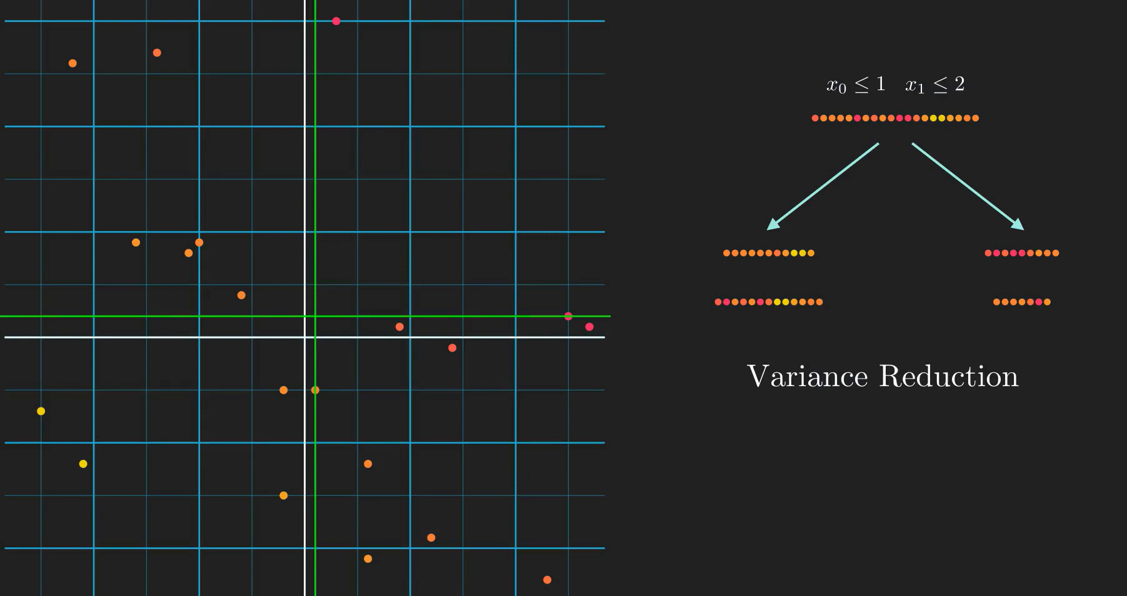
Selecting right feature for splitting:
Split based on x0
Split based on x1
This is the measure to check the purity in split.
Variance should be less.

Slide 9
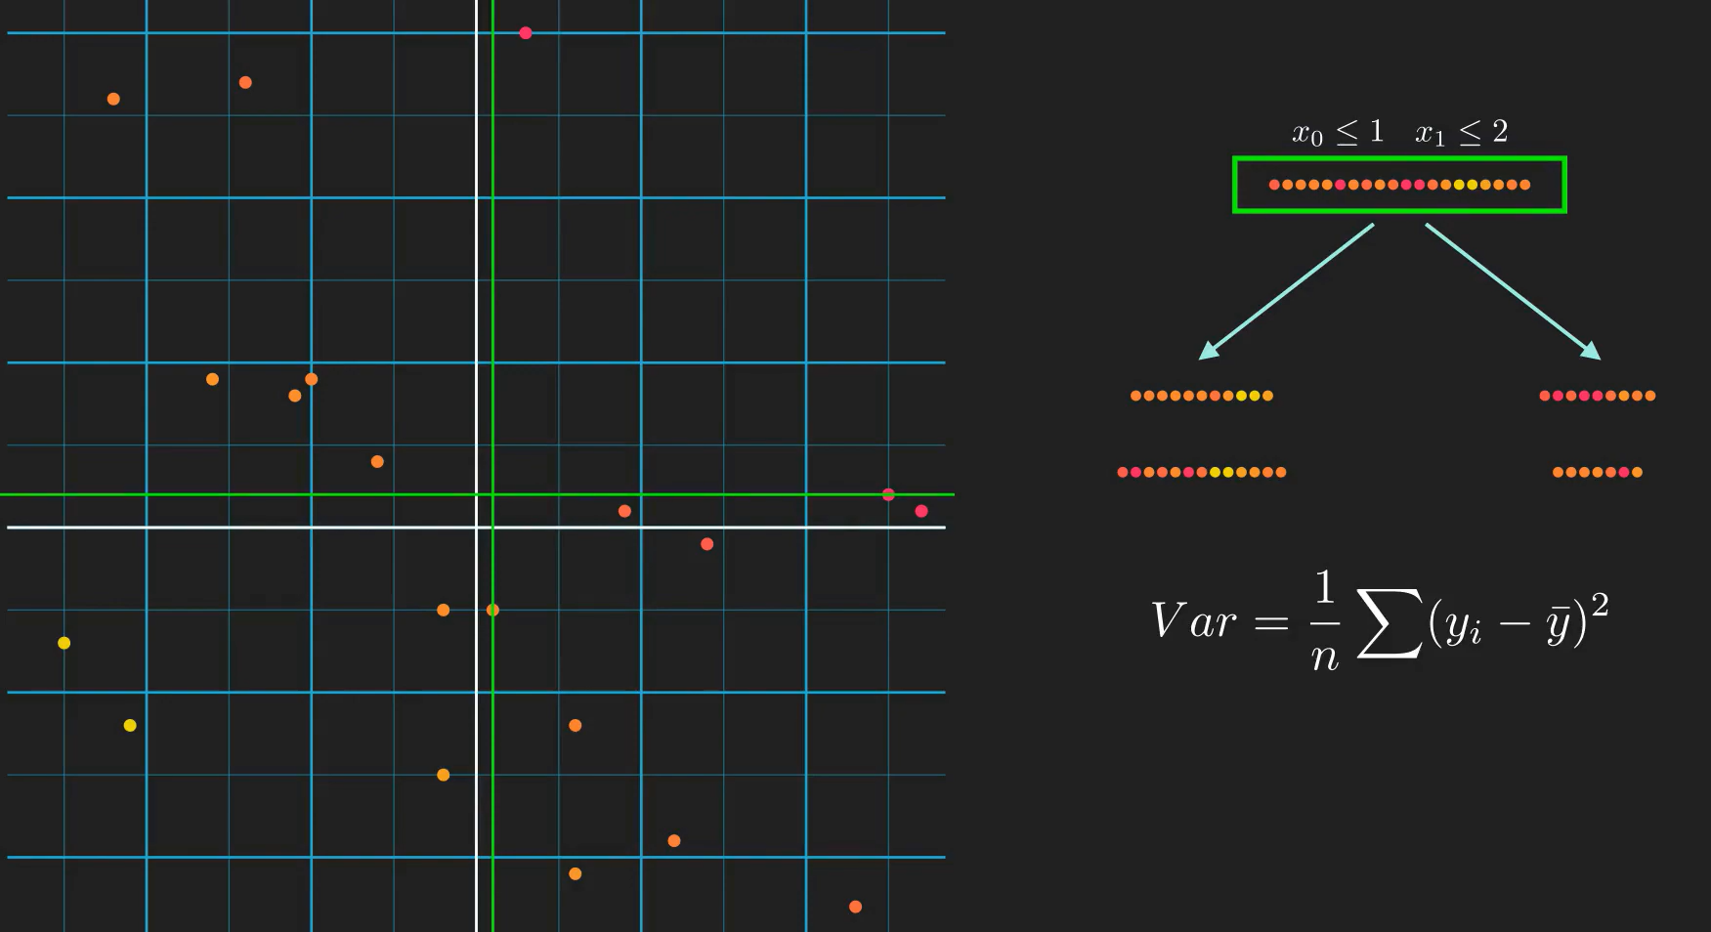

Slide 10
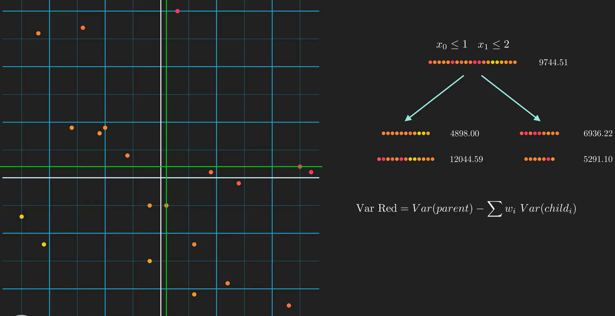

Slide 11
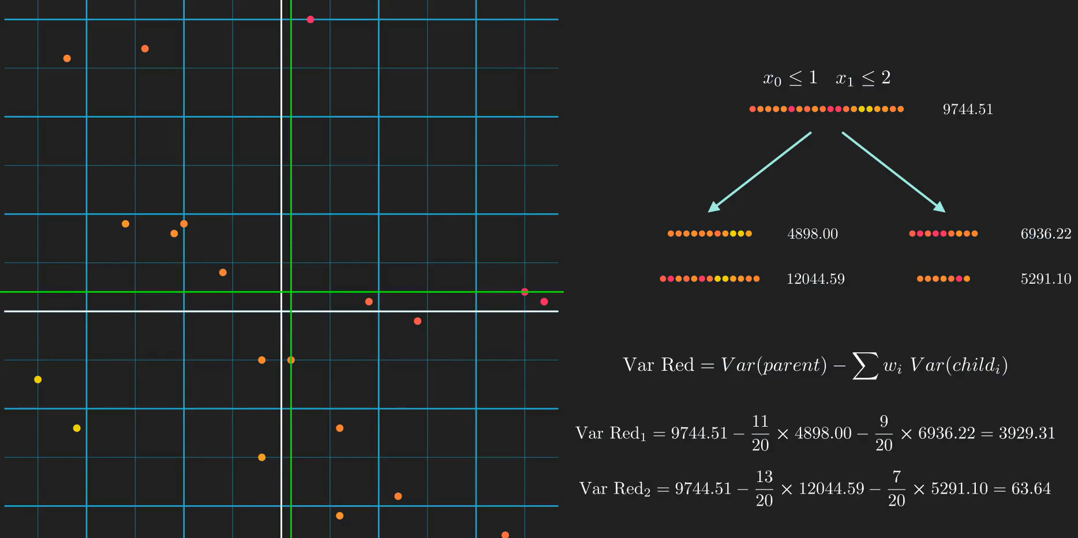

Slide 12
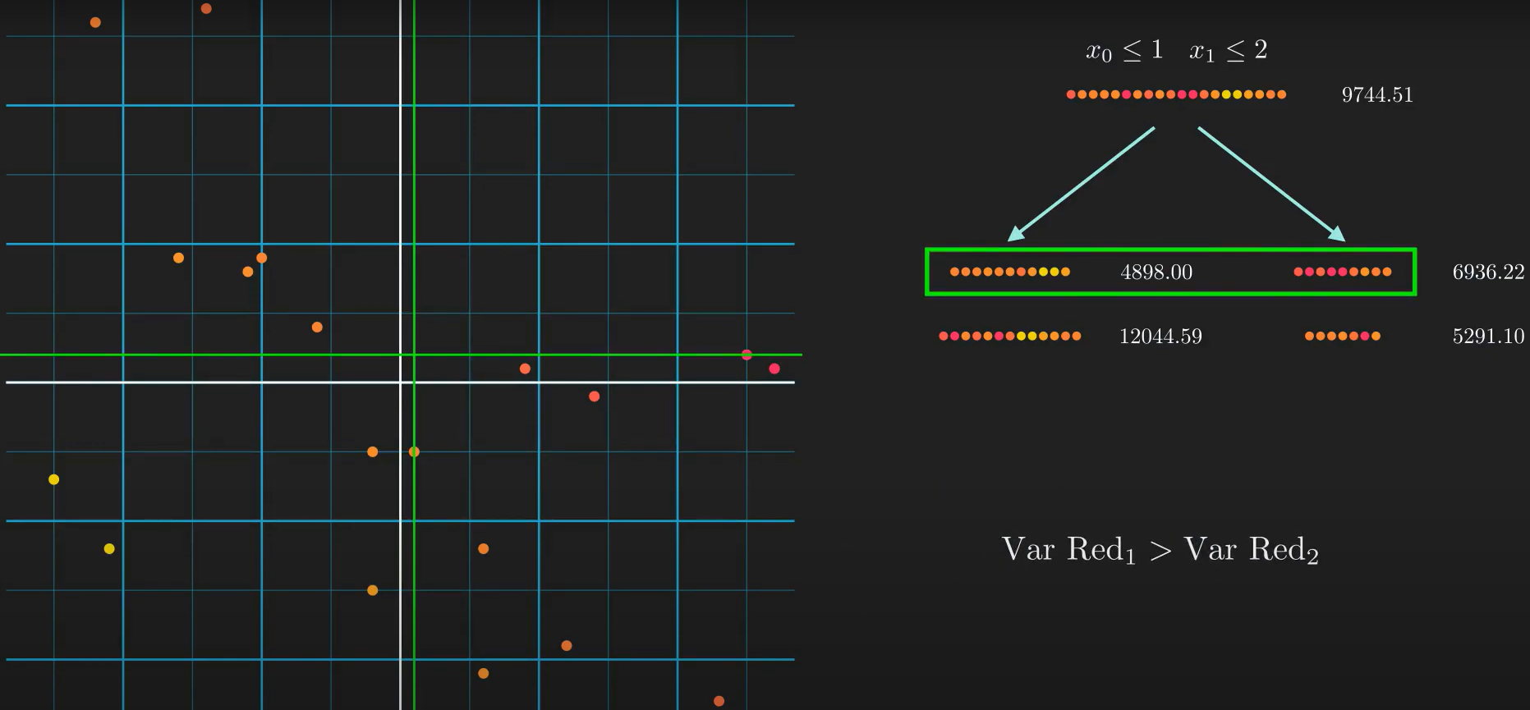

Slide 13
